Slide 1
Unit V – Optical Communication System
Design and Concepts

Slide 2

Point-to-Point Links
The simplest transmission link is a point to point link that has transmitter on one end and a receiver on the other end.
LED or laser
MMF or SMF
pin or APD
(a) Emission wavelength
(b) Spectral line width
(c) Output power
(d) Effective radiating area
(e) Emission pattern
(a) Core size
(b) Core index profile
(c) BW or dispersion
(d) Attenuation
(e) NA or MFD
(a) Responsivity
(b) Operating λ
(c) Speed
(d) Sensitivity
Fig. Simplex Point to Point Link
The cost and performance are very important factors in fiber optic communication links
These types of links are used at a less demand on optical fiber technology. The designer carefully chooses the components to give a desired performance over the expected lifetime.

Slide 3
Key system requirements needed to analyze optical fiber links:
1. The desired (or possible) transmission distance
2. The data rate or channel bandwidth
3. The desired bit-error rate (BER)

Slide 4
To fulfill these requirements the designer has a choice of the following components and their associated characteristics:
2. LED or laser diode optical source
(a) Emission wavelength
(b) Spectral line width
(c) Output power
(d) Effective radiating area
(e) Emission pattern
(f) Number of emitting modes
1. Multimode or single-mode optical fiber
(a) Core size
(b) Core refractive-index profile
(c) Bandwidth or dispersion
(d) Attenuation
(e) Numerical aperture or mode-field diameter
3. pin or avalanche photodiode
(a) Responsivity (~quantum efficiency)
(b) Operating wavelength
(c) Speed
(d) Sensitivity

Slide 5
System Considerations
1. Wavelength of operation:
In carrying out a link power budget, we first decide at which wavelength to transmit and then choose components operating in this region.
If the distance over which the data are to be transmitted is not too far, we may decide to operate in the 800 - 900-nm region.
On the other hand, if the transmission distance is relatively long, we may want to take advantage of the lower attenuation and dispersion that occurs at wavelengths around 1300 or 1550 nm.

Slide 6
System Considerations
2. Source:
The system parameters involved in deciding between the use of an LED and a laser diode are signal dispersion, data rate, transmission distance, and cost.
The spectral width of laser output is much narrower than that of an LED.
Since laser diodes typically couple from 10 to 15 dB more optical into a fiber than an LED, greater repeater less transmission distances are possible with a laser.
This advantage and the lower dispersion capability of laser diodes may be offset by cost constraints.
Not only is a laser diode itself is expensive than an LED, but also the laser transmitter circuitry is much complex.

Slide 7
System Considerations
3. Photo Detector:
In choosing a particular photodetector, we mainly need to determine the minimum optical power that must fall on the photodetector to satisfy the bit error rate (BER) requirement at the specified data rate.
A pin photodiode receiver is simpler, more stable with changes in temperature, and less expensive than an avalanche photodiode receiver.
In addition, pin photodiode bias voltages are normally less than 50 V, whereas those of avalanche photodiodes are several hundred volts.
However, the advantages of pin photodiodes may be overruled by the increased sensitivity of the avalanche photodiode if very low optical power levels are to be detected.

Slide 8
System Considerations
4. Optical fiber:
For the optical fiber we have a choice between single-mode and multi-mode fiber, either of which could have a step- or a graded-index core.
This choice depends on the type of light source used and on the amount of dispersion that can be tolerated.
Light-emitting diodes (LEDs) tend to be used with multimode fibers (although special LEDs called edge-emitting LEDs can launch sufficient optical power into a single-mode fiber for transmission at data rates up to 560 Mb/s over several kilometers.
The optical power that can be coupled into a fiber from an LED depends on the core-cladding index difference Δ, which, in turn, is related to the numerical aperture of the fiber (for Δ = 0.01 the numerical aperture NA = 0.21).
As Δ increases, the fiber-coupled power increases correspondingly.

Slide 9
System Considerations
4. Optical fiber (cont.):
However, since dispersion also greater with increasing Δ, a tradeoff must be made between the optical power that can be launched into the fiber and the maximum tolerable dispersion.
Either a single-mode or a multimode fiber can be used with a laser diode A single-mode fiber can provide the ultimate bit-rate-distance product, with values of 30 (Gb/s).km being achievable.
A disadvantage of single-mode fibers is that the small core size (5 to 16 µm in diameter) makes fiber splicing more difficult and critical than for multimode fibers having 50 µm core diameters.

Slide 10
Design Considerations
Link Power Budget Analysis
Power margin calculations between the transmitter and receiver considering attenuation, connectors, splices and other losses.
Rise Time Budget
Rise time calculations and speed of response of system considering various dispersive effects.
These two budgets give necessary conditions for satisfactory operation

Slide 11
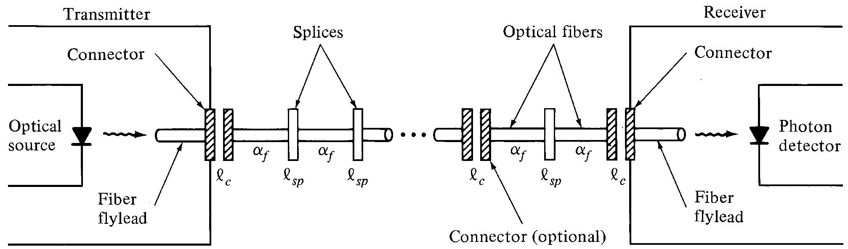
Optical power-loss model

Slide 12
Link Power Budget
The optical power received at the photodetector depends on,
The amount of light coupled into the fiber,
The losses occurring in the fiber, and
At the connectors and splices
Let l_{c} denotes the losses occur at the connector
l_{sp} denotes the losses at the splices, and
α_{f} denotes losses in the fiber
The link loss budget is derived from the sequential loss contributions of each element in the link. Each of these loss elements is expressed in decibels (dB) as,
Loss = 10 log (P_{out}/P_{in})
P_{in}- Optical power enter into the loss element,
P_{out} – Optical power output from the loss element

Slide 13
Link Power Budget
Link power margin considers the losses due to the component aging, temperature fluctuations and losses arising from the components
Usually a link margin of 6-8 dB is considered while estimating link power budget
The link power loss considers the total optical power loss P_{T} between the light source and photodetector. This loss is allocated to cable attenuation, connector loss, splice loss and system margin.
The total power loss (P_{T}) in the link is given by,
The total power loss = Optical power at light source – Optical power at receiver (or) Receiver sensitivity
P_{T}=P_{S}-P_{R}
Total optical power loss (P_{T}) = Connector loss + Splicing loss and fiber attenuation + System Margin
P_{T} = 2l_{c} + α_{f}L + P_{m}
Ps – Optical power emerging from the end of a fiber fly lead attached to the light source
P_{R} – Receiver sensitivity l_{c} – Connector loss α_{f} - Fiber attenuation in dB/km,
L – Transmission distance

Slide 14
Link Power Budget
Example:
Specifications: Data Rate 20 Mb/s, BER 10⁻⁹
Receiver: pin photodiode @ 850 nm → Required input signal = - 42 dBm
Optical source: GaAlAs LED with average optical power 50 µW = -13 dBm
Connector loss: 1 dB at both transmitter and receiver
System margin: 6 dB
Thus,
P_{T} = P_{S} – P_{R}
= 29 dB = 2(1 dB) + αL + 6 dB
αL = 21 dB
If α = 3.5 dB/km, then a 6-km transmission path is possible.

Slide 15
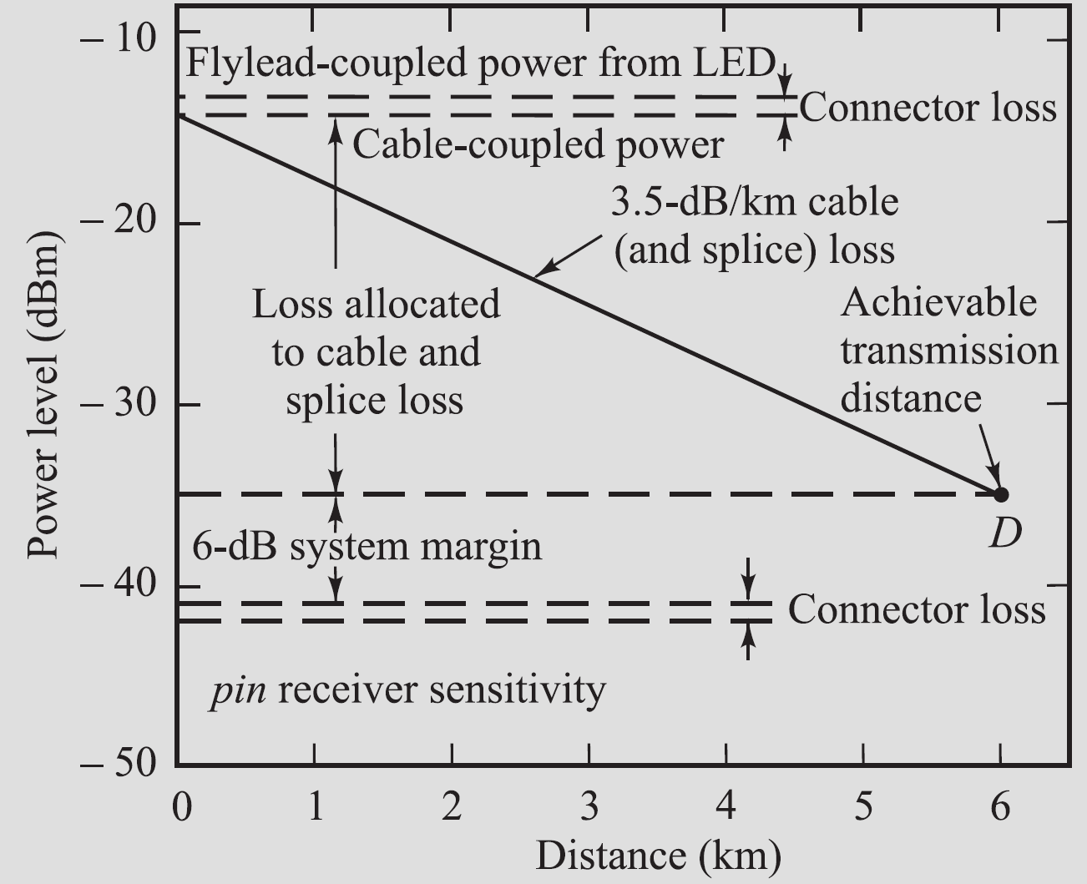
Link Power Budget
Graphical representation of a link loss budget for an 850-nm LED/pin system operating at 20 Mb/s.

Slide 16
Rise Time Budget
Rise time budget analysis determines the dispersion limitation of an optical fiber link
Total System Rise time (T_{sys}):
Here the total system rise time t_{sys} is the root sum square of the rise times from each contributor t_{i} to the pulse rise time degradation
Total rise time of a digital link should not exceed 70% for a NRZ bit period, and 35% of a RZ bit period

Slide 17
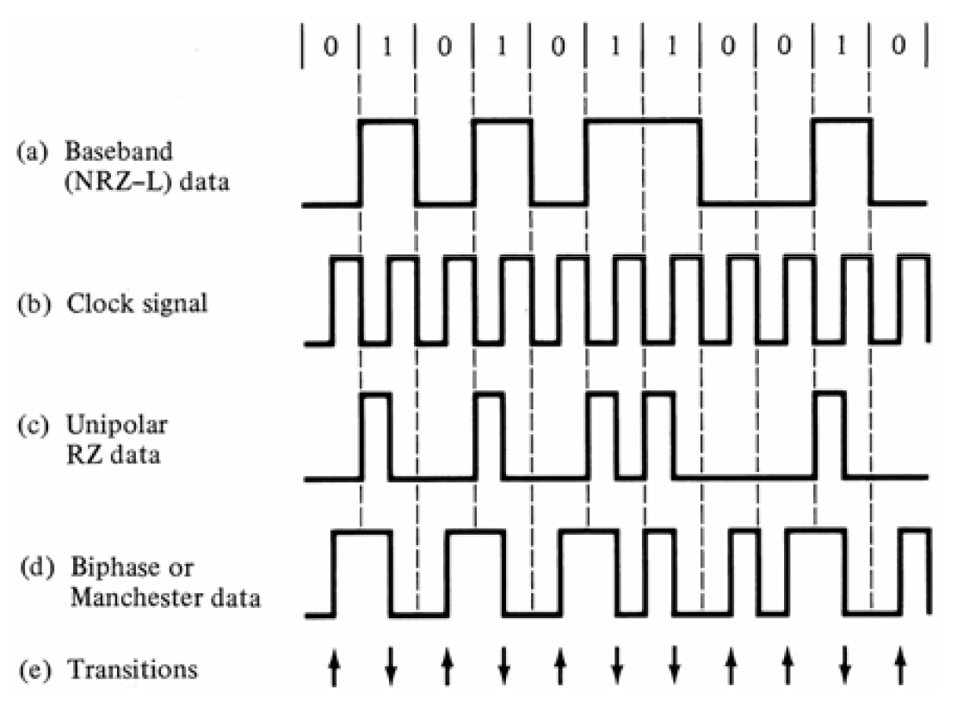
Two-level Binary Channel Codes

Slide 18
Rise Time Budget
The system speed is limited by,
Transmitter rise time r_{tx},
Model dispersion rise time (t_{mod}) of the fiber,
Group velocity dispersion (GVD) rise time t_{GVD} of the fiber, and
Receiver rise time t_{rx}
Hence, the total rise time t_{sys} becomes,
Since there is no model dispersion for SM fiber the rise time is related only to GVD.

Slide 19
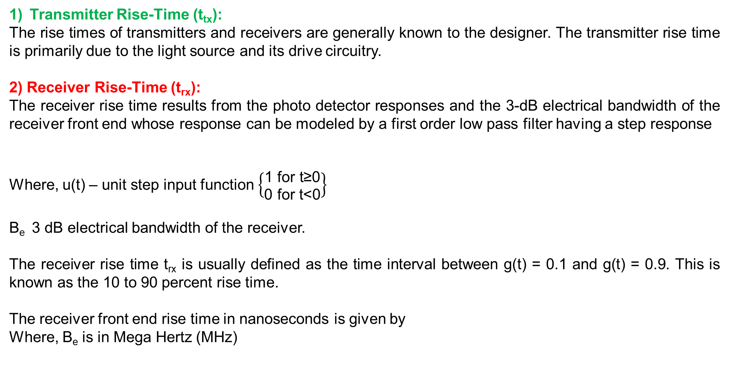
Rise Time Budget
Transmitter Rise-Time (t_{tx}):
The rise times of transmitters and receivers are generally known to the designer. The transmitter rise time is primarily due to the light source and its drive circuitry.
2) Receiver Rise-Time (t_{rx}):
The receiver rise time results from the photo detector responses and the 3-dB electrical bandwidth of the receiver front end whose response can be modeled by a first order low pass filter having a step response
Where, u(t) – unit step input function $\left\{\begin{aligned}\text{1 }\text{for} \text{t}\text{≥0} \\ \text{0 }\text{for} \text{t}\text{<0}\end{aligned}\right\}$
B_{e} 3 dB electrical bandwidth of the receiver.
The receiver rise time t_{rx} is usually defined as the time interval between g(t) = 0.1 and g(t) = 0.9. This is known as the 10 to 90 percent rise time.
The receiver front end rise time in nanoseconds is given by
Where, B_{e} is in Mega Hertz (MHz)

Slide 20
Rise Time Budget
3) Group velocity dispersion rise time (t_{GVD})
The group velocity dispersion rise time over a length L is given
Where, σ_{λ} Half spectral width of the source, and D Dispersion
To find the model dispersion rise time, bandwidth B_{M} in a link of length “L” can be expressed by empirical relation
Where, “q” is the parameter ranges between “0.5” and “1”, and
B₀ is the bandwidth of a 1 km length of cable

Slide 21
Rise Time Budget
At q=0.5, the steady stat model equilibrium has been reached and q=1 indicated little mode mixing. Based on the field experience, a reasonable estimate is q=0.7.
Based on the curve fitting of experimental data the bandwidth BM is given as
Where, Bn is the bandwidth of the n_{th} section.
The above equation can be written as
t_{M}(N) is the pulse broadening occurring over “N” cable sections, and
t_{n} is the individual pulse broadening.

Slide 22
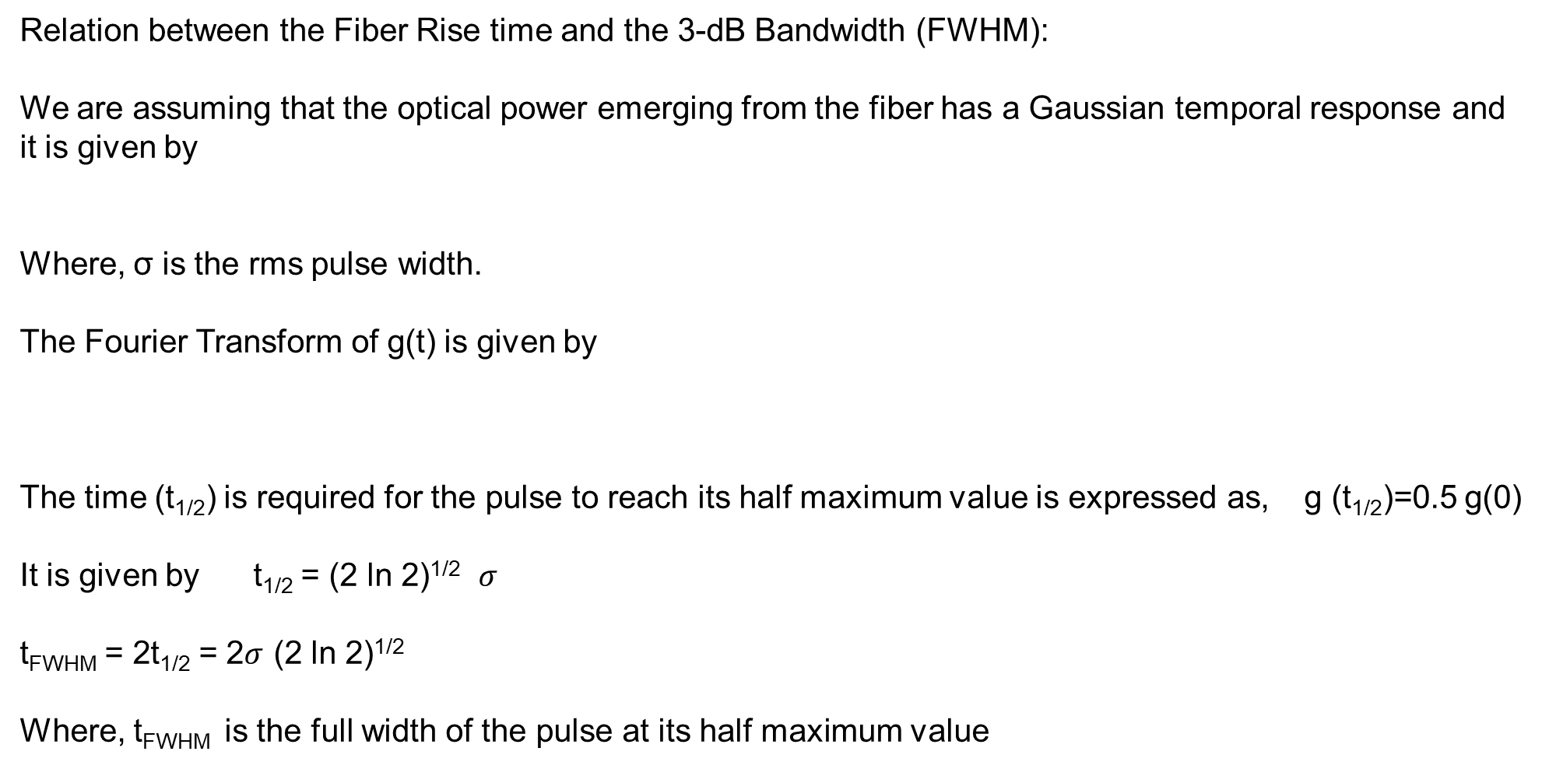
Relation between the Fiber Rise time and the 3-dB Bandwidth (FWHM):
We are assuming that the optical power emerging from the fiber has a Gaussian temporal response and it is given by
Where, σ is the rms pulse width.
The Fourier Transform of g(t) is given by
The time (t_{1/2}) is required for the pulse to reach its half maximum value is expressed as, g (t_{1/2})=0.5 g(0)
It is given by t_{1/2} = (2 ln 2)^{1/2} $σ$
t_{FWHM} = 2t_{1/2} = 2$σ$ (2 ln 2)^{1/2}
Where, t_{FWHM} is the full width of the pulse at its half maximum value

Slide 23
Relation between t_{FWHM} and 3-dB Optical Bandwidth:
The 3-dB optical bandwidth B_{3dB} is defined as, “the modulation frequency f_{3dB} at which the received optical power has fallen to 0.5 of the zero frequency value”.
If t_{FWHM} is the rise time resulting from model dispersion and it is given by,
If t_{mod} and BM are expressed in nanoseconds and MHz respectively, then

Slide 24
Total Rise Time
The total rise time t_{sys} is
Where all the times are given in nanoseconds,
σ_{λ} is the half power spectral width of the source, and
the dispersion D is in ns/(nm.km) and is 0.07 ns/(ns.km) in the 800-900 nm region.
This is due to the material dispersion for a dispersion shifted fiber and it is given by

Slide 25
Rise-time budget for a multimode link
Example:
Specifications: Data Rate 20 Mb/s, BER 10⁻⁹
LED : rise time 15 ns; spectral width 40 nm;
Fiber : material-dispersion related rise time 21 ns over 6 km link;
400 MHz·km bandwidth-distance product, q = 0.7 →t_{mod} =3.9 ns
Receiver : 25 MHz bandwidth → t_{rx} =14 ns
= 30 ns
For 20 Mb/s NRZ system, T_{b,NRZ} = 50 ns. Thus, t_{sys} < 0.7T_{b,NR}Z and the rise-time requirement is met.

Slide 26
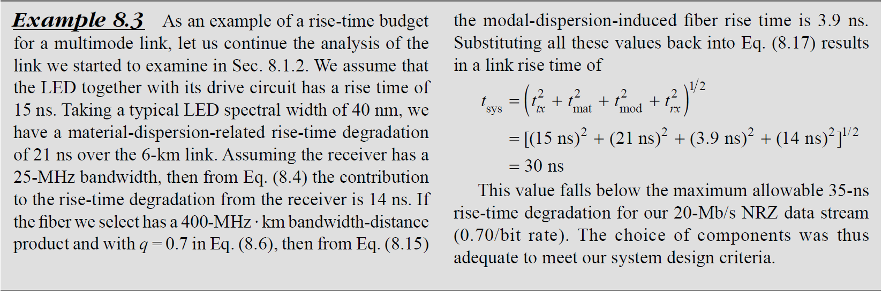

Slide 27
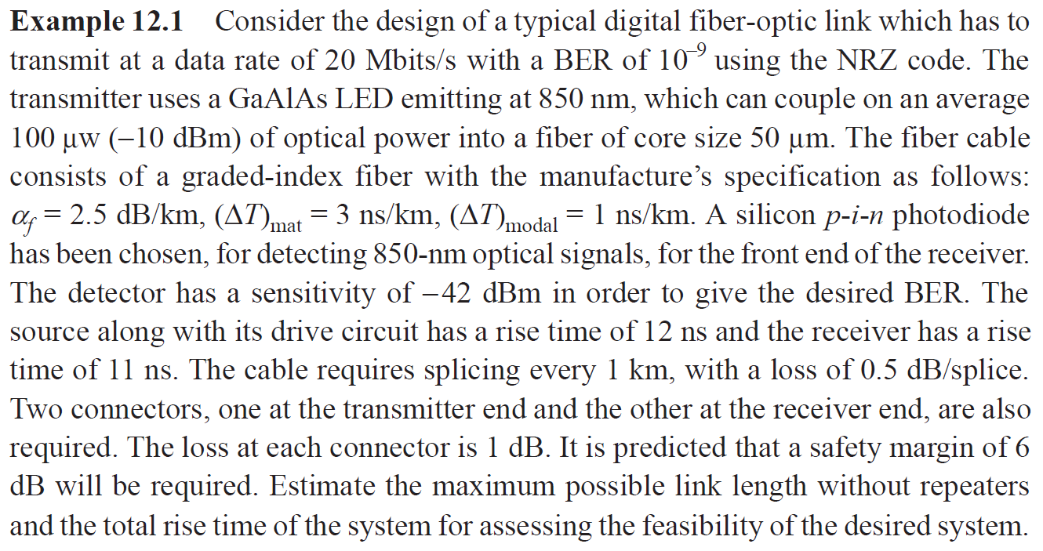

Slide 28
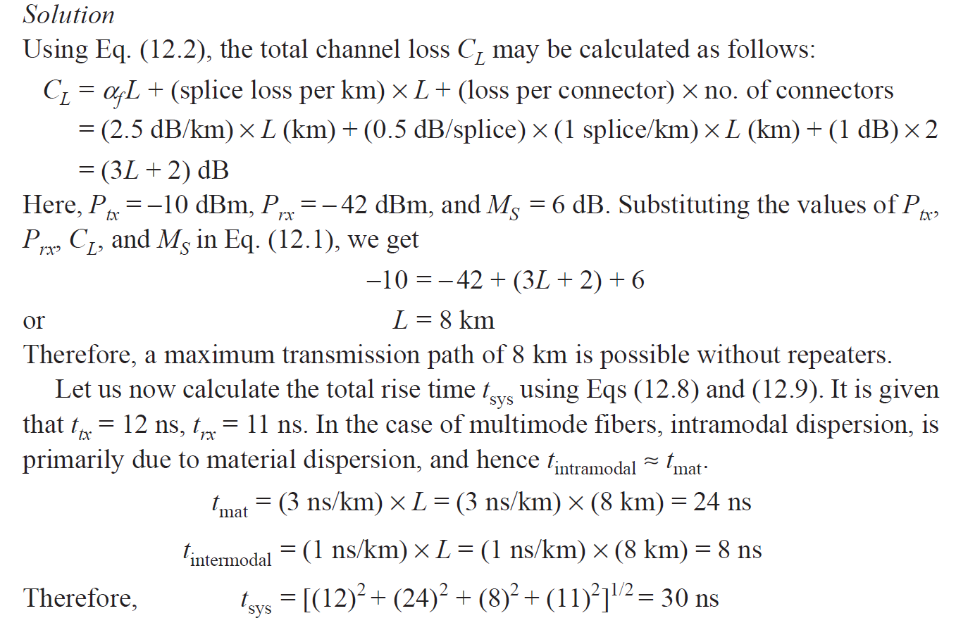

Slide 29
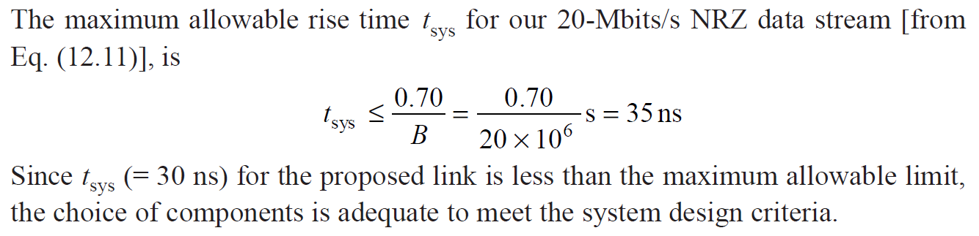

Slide 30
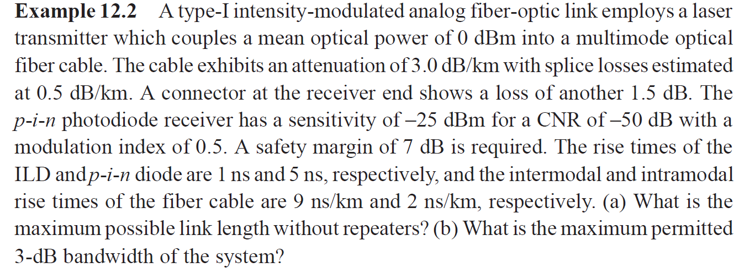

Slide 31
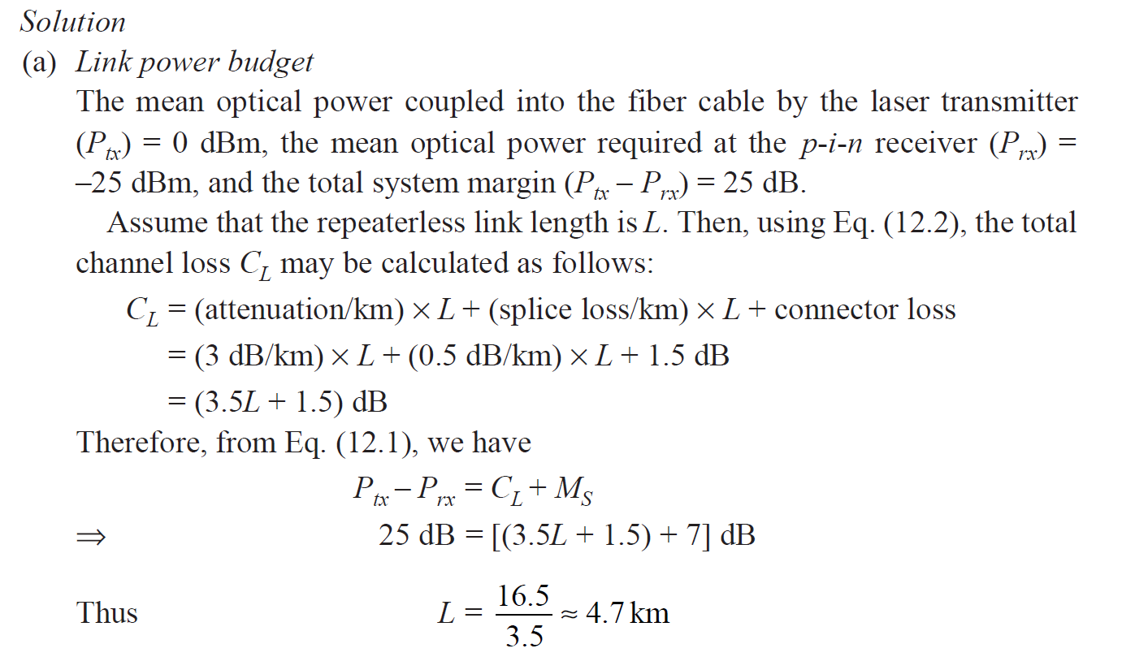

Slide 32
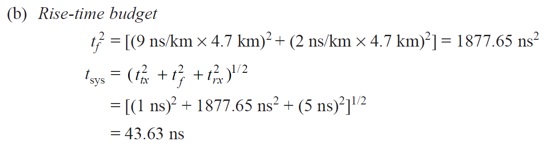
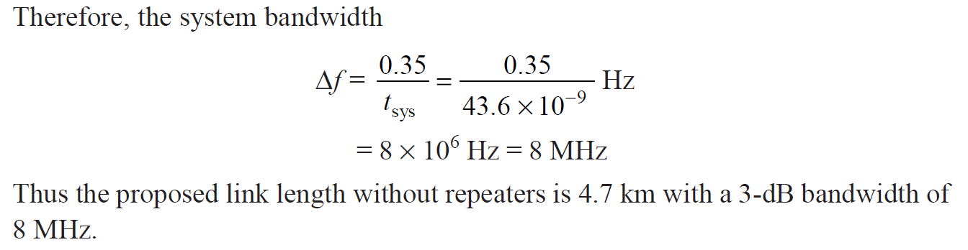

Slide 33
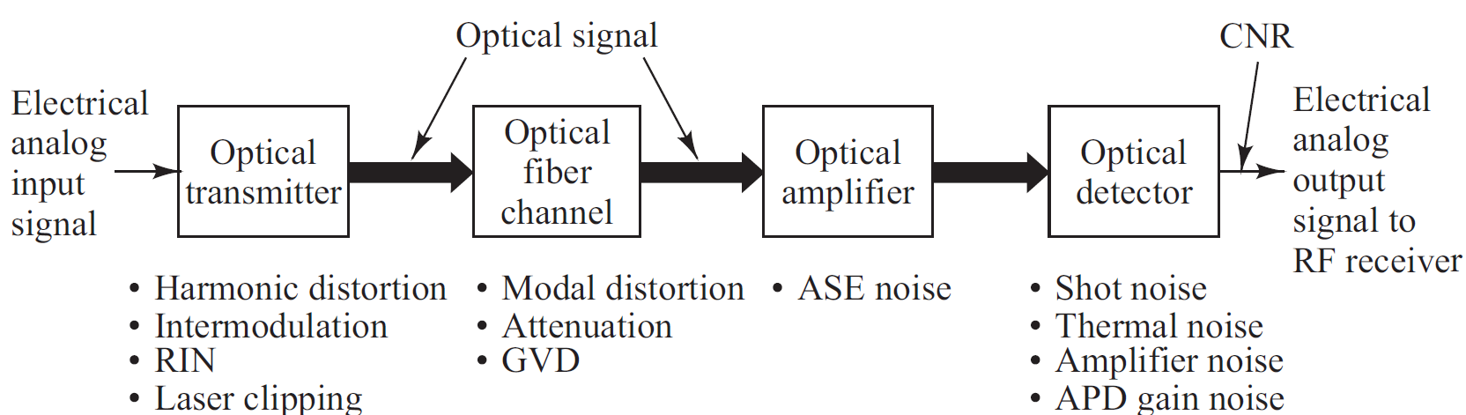
Analog Communication Links
Analog (RF) links are used where converting to digital signals is undesirable, including
• Analog TV and audio services
• Cable modem services
• Microwave-multiplexed signals (e.g., satellite base stations)
• Radar signal processing

Slide 34
Overview of Analog Links
A bias point on the source is set approximately at the midpoint of the linear output region. The analog signal can then be sent with direct intensity modulation technique.
Other modulation techniques include AM, FM and PM, which first convert baseband signal onto an electrical subcarrier prior to intensity modulation.
Signal impairments in optical source : harmonic distortions, inter-modulation (IM) products, RIN in the laser, and laser clipping.
The fiber should have a flat amplitude and group-delay response within the passband required to send the signal free of linear distortion.
Since modal-distortion-limited bandwidth is difficult to equalize, it is best to choose a single-mode fiber.

Slide 35
Radio Over Fiber (RoF) Link design and Performance Parameter

Slide 36
Radio Over Fiber (RoF)
Radio frequency (RF) signals at microwave and millimetre-wave frequencies are used in applications such as radars, satellite links, broadband terrestrial radios, and cable television networks.
The signal ranges include the
0.3- to 3-GHz ultra-high frequency (UHF) band,
3- to 30-GHz super-high frequency (SHF) region, and
30- to 300-GHz extremely high frequency (EHF) range.
Traditionally these RF systems used wireless or coaxial cable links for transporting the microwave signals from a receiving element (Ex. an antenna) to a signal processing centre, which could be located hundreds of meters away.
The methods for transmitting microwave analog signals over an optical fiber link have become known as RF-over-fiber techniques.

Slide 37
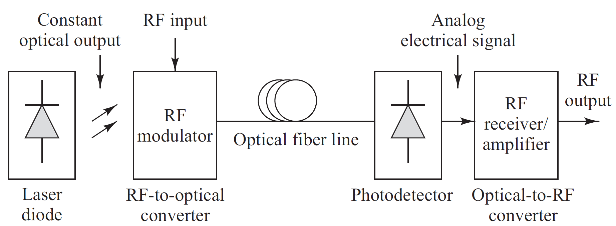
Generic RF–over-fiber Link
Fig: Basic constituents of a generic RF-over-fiber link
Three Major Modules:
An RF-to-optical signal converting device at the transmitting end,
An optical-to-RF signal converting device at the receiving end, and
An optical fiber that joins these two modules.

Slide 38
Radio Over Fiber (RoF)
Radio over fiber (RoF) refers to a technology whereby light is modulated by a radio frequency signal and transmitted over an optical fiber link.
Main technical advantages of using fiber optical links are
lower transmission losses and
reduced sensitivity to noise and electromagnetic interference compared to all-electrical signal transmission.
Applications range from the transmission of mobile radio signals (3G, 4G, 5G and Wi-Fi) and the transmission of cable television signals (CATV) to the transmission of RF L-Band signals in ground stations for satellite communications.
Access to dead zones
An important application of RoF is its use to provide wireless coverage in the area where wireless backhaul link is not possible. These zones can be areas inside a structure such as a tunnel, areas behind buildings, Mountainous places or secluded areas such as jungles.

Slide 39
RoF – for Wireless Communication
In the area of Wireless Communications one main application is to facilitate wireless access, such as 5G and Wi-Fi simultaneous from the same antenna. In other words, radio signals are carried over fiber-optic cable.
A single antenna can receive any and all radio signals (5G, Wi-Fi, cell, etc..) carried over a single-fiber cable to a central location where equipment then converts the signals; this is opposed to the traditional way where each protocol type (5G, Wi-Fi, cell) requires separate equipment at the location of the antenna.
In RoF systems, wireless signals are transported in optical form between a central station and a set of base stations before being radiated through the air.
Each base station is adapted to communicate over a radio link with at least one user's mobile station located within the radio range of said base station.

Slide 40
RoF - Advantages
The advantage is that the equipment for Wi-Fi, 5G and other protocols can be centralized in one place, with remote antennas attached via fiber optic serving all protocols. It greatly reduces the equipment and maintenance cost of the network.
RoF technology enables convergence of fixed and mobile networks.
FTTA (Fiber to the antenna)
By using an optical connection directly to the antenna, the equipment vendor can gain several advantages like low line losses, immunity to lightning strikes/electric discharges and reduced complexity of base station by attaching lightweight optical-to-electrical (O/E) converter directly to antenna

Slide 41
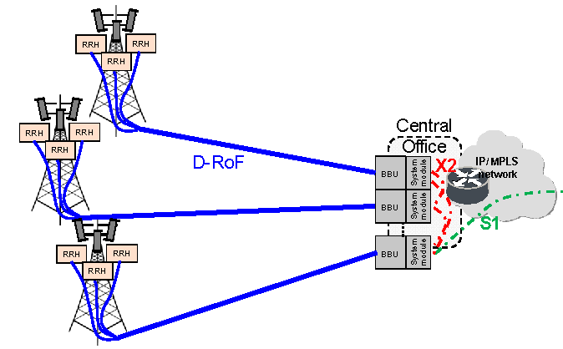
Radio over Fiber (RoF)
Radio frequency (RF) is carried over optical fiber
Between a central office (CO) and multiple low-cost remote antenna units (RAU) or radio remote head (RRH).
(RAUs) referred for microcellular radio systems
(RRHs) referred for distributed antenna system (DAS)

Slide 42
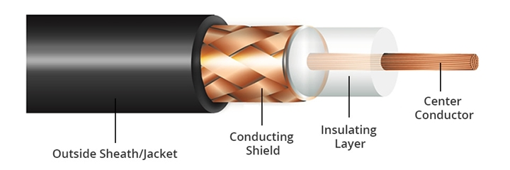
History
Coaxial copper cable carrying RF signal
Low Bandwidth (750 MHz)
Attenuation is 26dB per 30m for 750MHz bandwidth
Attenuation is 6.6dB per 30m for 50MHz bandwidth
Typical Distance of co-axial copper cable is 500m
High cost $13 per 30m
Heavy
Difficult to maintain and install due to dielectric insulating layer.
The co-axial cables are evolved as parallel copper cables like CAT5, CAT6 and HDMI cables to improve bandwidth.

Slide 43
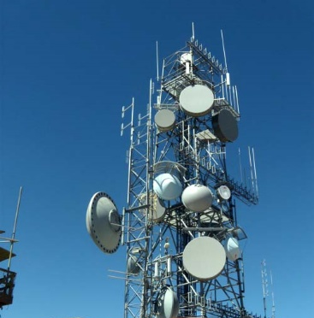
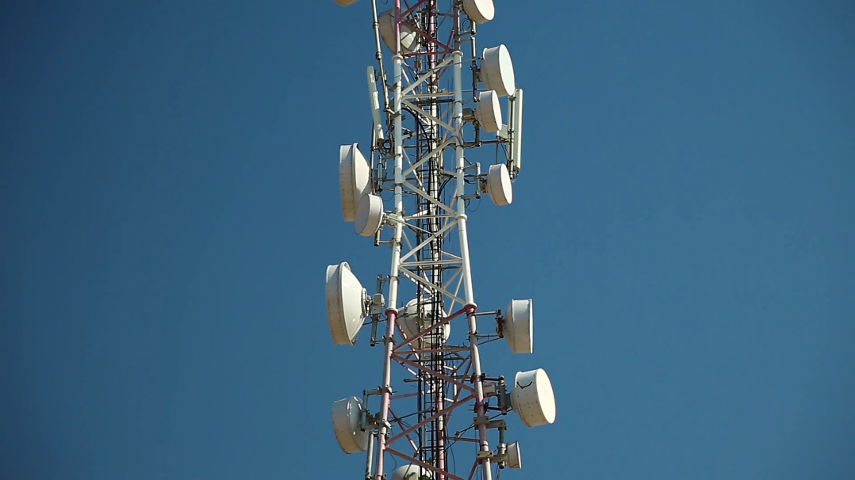
History
Microwave carrying RF signal
Moderate Bandwidth (100 GHz)
Attenuation is 10 dB/km (high dependence on channel condition and operational frequency)
Typical Distance of 3 to 5km
Line of sight to achieve high data rate.
Easy to deploy and transfer
Limited Capacity (Few Gbps)
RF signal is transmitted over µwave due to growing bandwidth demand
µwave for communication ranges from 1GHz to 100GHz
As frequency increases the transmitter and receiver module become more expensive
Link length of the system decreases, cell size decreases.

Slide 44
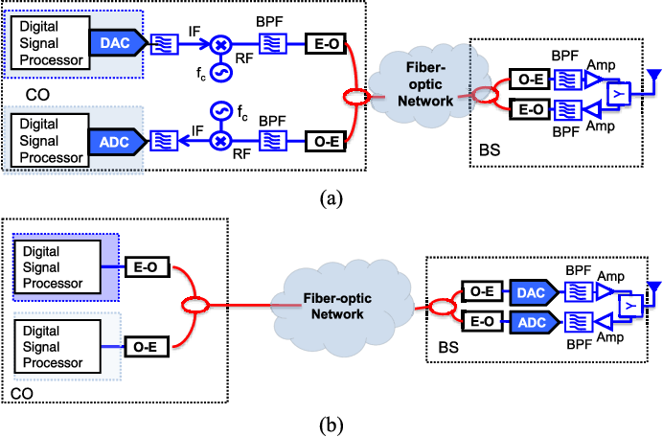
Radio over Fiber
Fiber attenuation is fixed for all the transmitting frequency typically 0.5 dB/km
Offers enormous bandwidth
Can carry up to 50km of fiber length
Signal can be distributed and processed separately
Light weight fibers quick to deploy and economic solution

Slide 45
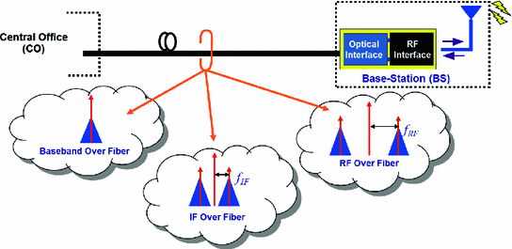
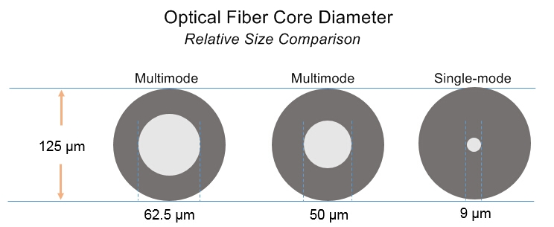
Categories of Radio over Fiber Systems
Types of Transport
RF over fiber
IF over fiber
Digitized IF over fiber or Baseband over fiber
Types of Modulation
Double sideband with carrier
Double sideband suppress carrier
Single sideband with carrier
Types of Fiber
Single mode fiber (SMF)
Multimode fiber (MMF)

Slide 46
RF - over fiber
In RF-over-fiber architecture, a data-carrying RF (radio frequency) signal with a high frequency is imposed on a light wave signal before being transported over the optical link.
Therefore, wireless signals are optically distributed to base stations directly at high frequencies and converted from the optical to electrical domain at the base stations before being amplified and radiated by an antenna.
As a result, no frequency up–down conversion is required at the various base stations, thereby resulting in simple and rather cost-effective implementation is enabled at the base stations

Slide 47
IF-over-fiber
In IF-over-fiber architecture, an IF (intermediate frequency) radio signal with a lower frequency is used for modulating light before being transported over the optical link.
Therefore, before radiation through the air, the signal must be up-converted to RF at the base station.

Slide 48
Radio Over Fiber Parameters - Link Gain
The Link Gain (G) is defined as the ratio of the RF power P_{out} generated in the photodetector load resistor to the RF power input P_{in} to the laser transmitter
For a directly modulated link, the gain is
Where
S_{M} is the slope efficiency (W/A) of the modulation device
η_{LF} is the laser to- fiber coupling efficiency
T_{F} is the fiber transmission efficiency
η_{FD} is the fiber-to-detector coupling efficiency
R is the photodetector responsivity (A/W)
R_{load} is the detector load resistance, and
R_{M} is the modulator resistance.
The two major contributors to the maximum value of the gain are
The limits of the modulator slope efficiency and
The photodetector responsivity.
The values of the other parameters do not vary significantly.

Slide 49
Radio Over Fiber Parameters - Link Gain
Typical parameter values for a 500-m RF-over-fiber link
Parameter | Symbol | Value
Slope Efficiency | S_{M} | 0.3 W/A
Coupling Efficiencies | η_{LF} and η_{FD} | 0.80
Fiber transmission efficiency | T_{F} | 0.7
Detector load resistance | R_{load} | 50 Ω
Modular resistance | R_{M} | 45 Ω

Slide 50
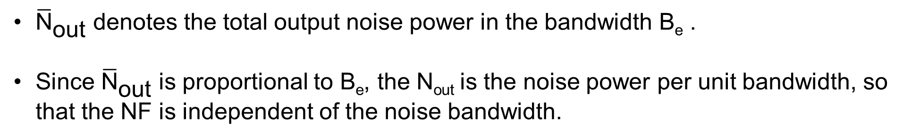
Radio Over Fiber Parameters – Noise Figure
The Noise Figure (NF) represents a measure of the degradation in the signal-to-noise ratio (SNR) between the input and the output of the link. It is usually defined in decibels.
where
The input noise is the thermal noise power generated by a matched resistive load k_{B}T held at T = 290°K.
The parameter k_{B} is Boltzmann’s constant and
B_{e} is the noise bandwidth of the electronic receiver.
${\overline{\text{N}}}_{\text{out}}$ denotes the total output noise power in the bandwidth B_{e} .
Since ${\overline{\text{N}}}_{\text{out}}$ is proportional to B_{e}, the N_{out} is the noise power per unit bandwidth, so that the NF is independent of the noise bandwidth.

Slide 51
Radio Over Fiber Parameters – Noise Figure
At the link output the noise power is due to the laser RIN, photodetector shot noise, and thermal noise.
Their contributions per unit noise bandwidth (in A²/Hz) are given by
where I_{p} is the average photodiode current in the receiver.
Thermal noise imposes a poorly performing limit on the SNR for low values of the photodetector current.
At higher detector currents, the RIN of the laser restricts the SNR to an upper value that cannot be exceeded even if the photodiode current is increased.

